Slide 1
Environment & Economics
Water pollution on NYC Gowanus canal

Slide 2
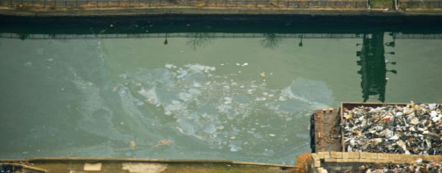
Introduction
Economics is defined as a science which uses theories, methods, and values to understand how goods and services are produced in the society in an efficient way. On the other hand, the environment is the natural earth place which hosts resources and life for its habitats. Economic discipline plays a major role in sustainable development. Environmental economics takes care of the environment and policies therein and how economic activities affect the environment.
The key environmental economics approach is to balance environmental degradation and economic activity. The topic also gives a limelight on how the environment can be advanced economically (Singh, & Shishodia, 2017).

Slide 3
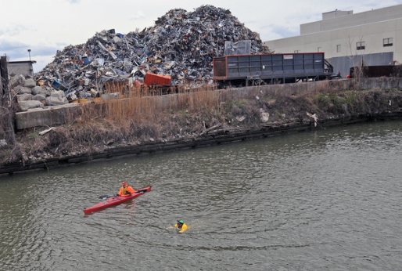
Water pollution on NYC Gowanus canal
Surrounding this canal are three manufactured gas plants which are believed to be the sources of polycyclic aromatic hydrocarbon contamination. Other companies which has greatly contributed to pollution of the Gowanus Canal include; Metropolitan Gas Light Company MGP site. The sites also exhibit characteristics ad contaminations of coal and tar which has affected to the quality of water in the canal.

Slide 4
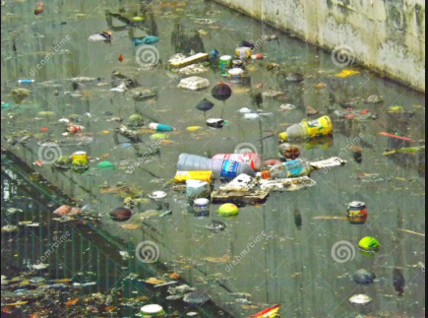
Research findings
The research realized that environmental economics is so important. Looking at the economic activities taking place on NYC Gowanus canal, it is evident that people use natural resources to make a living through agricultural activities, and fishing. Therefore, it means without the environment or nature, there would be little going on in terms of economic activities around the canal (Alexiou, 2015).
The researcher came up with various environmental economics concerns which are the subject of discussion in the study. The following research findings were realized;
It is important to make policies that promote a clean environment in Gowanus Canal. However, this can be achieved through government intervention in the economy in order to reduce pollution and so on.
The environmental objectives involve a number of key areas such as environmental quality, sustainable development, and biodiversity (Hirsch, & Teicher, 2016).

Slide 5
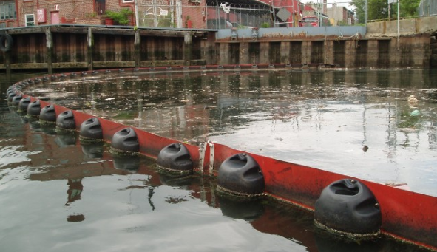
Environmental and economic importance of the topic.
Environmental economics is concerned with the efficient use of resources in order to give a direct value and the raw material which are needed for economic purposes. Therefore, the economy in Gowanus Canal depends on the environment. From an economic view of the environment, both principles need each other in order to co-exist. (O'Neill, & Van, 2016).
The topic takes the researcher as well as the audience in a journey towards a safer and cleaner environment. It is fair to say that, we can’t do away with economic activities in order to keep a clean environment.

Slide 6
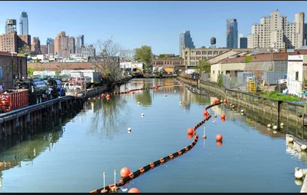
Effects on the environment and economy
The environment takes care of and the same should reciprocate on the other hand. There are a number of typical Environmental Economics issues that affect the system. For example depletion of resources in Gowanus Canal and so forth, it is important for the human community to come up with policies which regulate how economic activities make use of the environment in order to protect it. When untreated waste from the companies surrounding Gowanus Canal is released into the river,it affects the environment. Environmental economics teaches us that we should make regulations which protect the land, the habitats, and resources available.

Slide 7
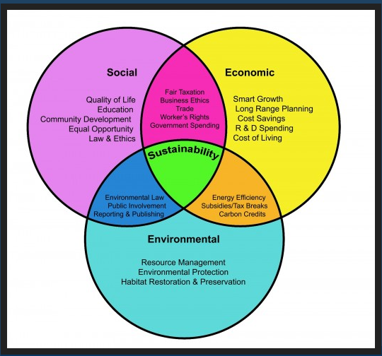
Sustainable environment

Slide 8
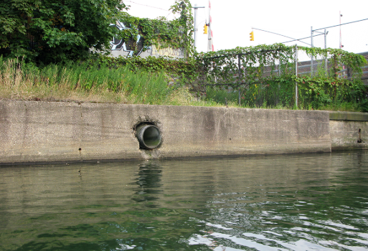
Conclusion
It is mandatory to acknowledge the value of the environment in economic growth as well as the goods or materials provided by the Earth’s environmental systems. Environmental economics plays an important role when the world is facing environmental issues in both local and international levels. Environmental economics spells out a number of key issues which surround the misuse of the natural environment as well as the decision making in environmental policing across the world

Slide 9
Conclusion
Alexiou, J. (2015). Gowanus: Brooklyn's Curious Canal. New York: NYU Press.
Hirsch, S., & Teicher, J. G. (2016). Gowanus waters.
In Dasgupta, P., In Pattanayak, S., & In Smith, V. K. (2018). Handbook of environmental economics: Volume 4.
Goodstein, E. S. (2019). Economics and the environment. New York: John Wiley & Sons.
O'Neill, K. M., & Van, A. D. J. (2016). Taking chances: The coast after Hurricane Sandy. Environmental economics: A very short introduction. Oxford: Oxford University Press.
Singh, K., & Shishodia, A. (2017). Environmental economics: Theory and applications. Los Angeles: SAGE Publications.

